Slide 1
Global Alignment

Slide 2
Objectives
What is global alignment in image processing?
Understand about Bundle adjustment.
Study some local adjustments, such as parallax removal
Study panorama recognition

Slide 3
Global Alignment
Global alignment refers to the problem of finding the image registration parameters that best comply with the constraints introduced by the image matching.
The goal is then to find a globally consistent set of alignment parameters that minimize the mis-registration between all pairs of images

Slide 4
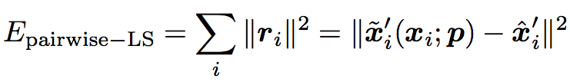
Bundle Adjustment
One way to register a large number of images is to add new images to the panorama one at a time, aligning the most recent image with the previous ones already in the collection
Bundle adjustment is the process of simultaneously adjusting pose parameters for a large collection of overlap- ping images
Consider the feature-based alignment problem given

Slide 5



Bundle Adjustment
The equation mapping a 3D point xi into a point xij in frame j can be re-written
Where Rj is a rotation matrix and is a calibration matrix
The motion mapping a point xij from frame j into a point xik in frame k is similarly given by:

Slide 6
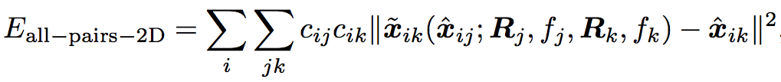
Bundle Adjustment
Multiview formulation
where the x ̃ik function is the predicted location of feature i in frame k, xˆij is the observed location
In practice, if we have enough features, we can directly minimize the above quantity using regular non-linear least squares and obtain an accurate multi-frame alignment.

Slide 7
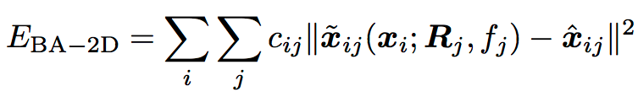

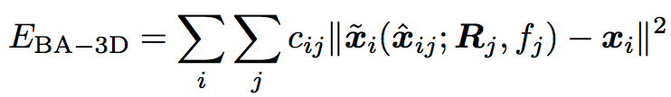
Bundle Adjustment
Formulate the optimization is to use true bundle adjustment
Where is given by above equation.
Alternative formulation is to minimize the error in 3D projected ray directions

Slide 8
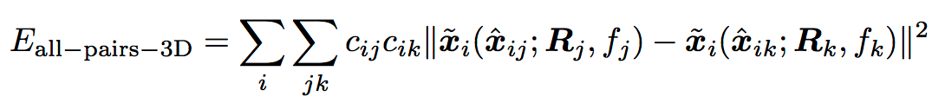
Bundle Adjustment
If we eliminate the 3D rays xi, we can derive a pairwise energy formulated in 3D ray space

Slide 9
Parallax removal
Parallax is a displacement or difference in the apparent position of an object viewed along two different lines of sight, and is measured by the angle or semi-angle of inclination between those two lines
When the motion is reasonably small, general 2D motion estimation can be used to perform an appropriate correction before blending using a process called local alignment
Global bundle adjustment is used to optimize the camera poses. Once these have been estimated, the desired location of a 3D point xi can be estimated as the average of the back-projected 3D locations

Slide 10
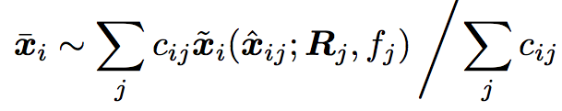
Parallax removal
the average of the back- projected 3D locations
The accuracy of the flow vector is checked using a photo-consistency measure before a given warped pixel is considered valid and is used to compute a high dynamic range radiance estimate, which is the goal of their overall algorithm.
The requirement for a reference image makes their approach less applicable to general image mosaicing, although an extension to this case could certainly be envisaged.

Slide 11
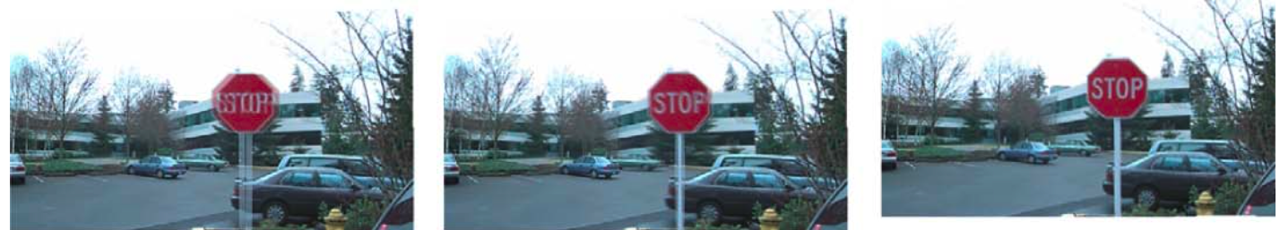
Parallax removal
composite with parallax
after a single deghosting step (patch size 32)
after multiple steps

Slide 12
Recognizing panoramas
Recognizing panoramas is perform fully automated image stitching is a technique to recognize which images actually go together.
If the user takes images in sequence so that each image overlaps its predecessor and also specifies the first and last images to be stitched, bundle adjustment combined with the process of topology inference can be used to automatically assemble a panorama
Users often jump around when taking panoramas such as may start a new row on top of a previous one, jump back to take a repeat shot, or create 360◦ panoramas where end-to-end overlaps need to be discovered

Slide 13
Recognizing panoramas
To recognize panoramas, we first find all pairwise image overlaps using a feature-based method and then find connected components in the overlap graph to “recognize” individual panoramas
The feature-based matching stage first ex- tracts scale invariant feature transform (SIFT) feature locations and feature descriptors from all the input images and places them in an indexing structure
The nearest matching neighbor is found for each feature in the first image, using the indexing structure to rapidly find candidates and then comparing feature descriptors to find the best match

Slide 14
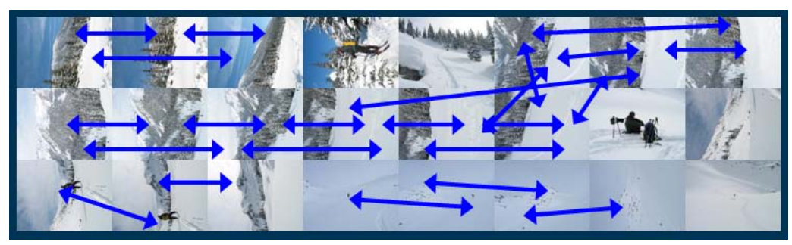
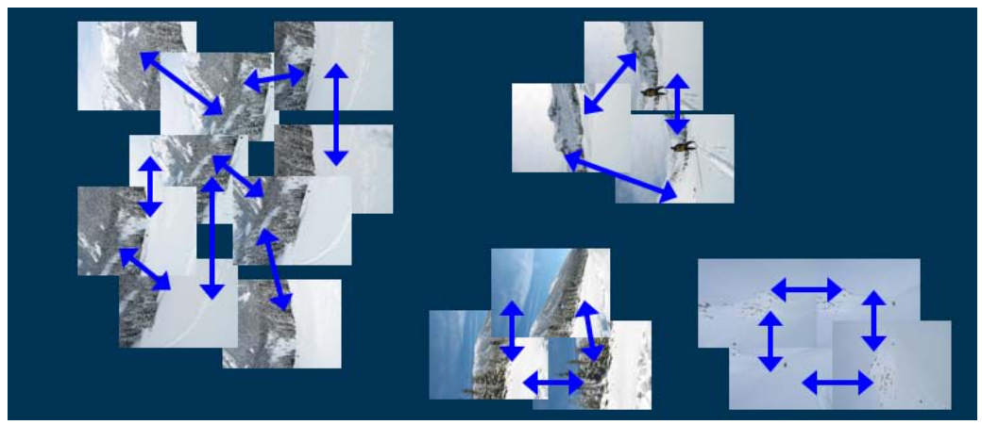
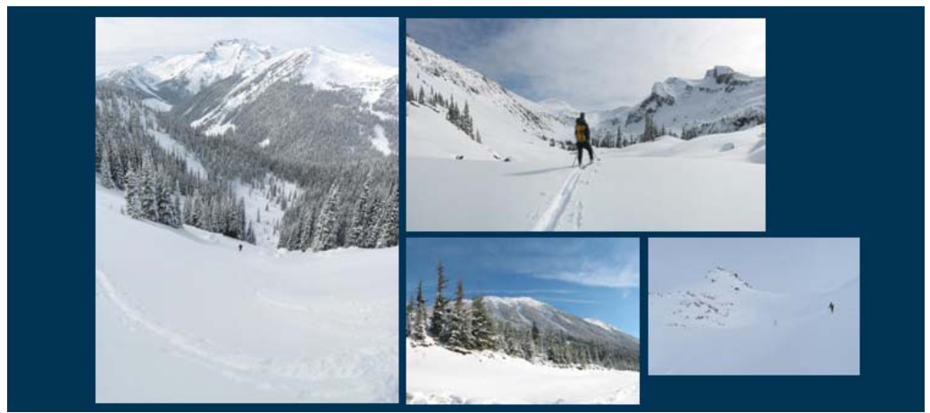
Recognizing panoramas
input images with pairwise matches
images grouped into connected components (panoramas)
individual panoramas registered and blended into stitched composites.

Slide 15
Recognizing panoramas
The most difficult part of getting a fully automated stitching algorithm to work is deciding which pairs of images actually correspond to the same parts of the scene. Repeated structures such as windows as show in image below can lead to false matches when using a feature-based approach
→ One way to mitigate this problem is to perform a direct pixel- based comparison between the registered images to determine if they actually are different views of the same scene.

Slide 16
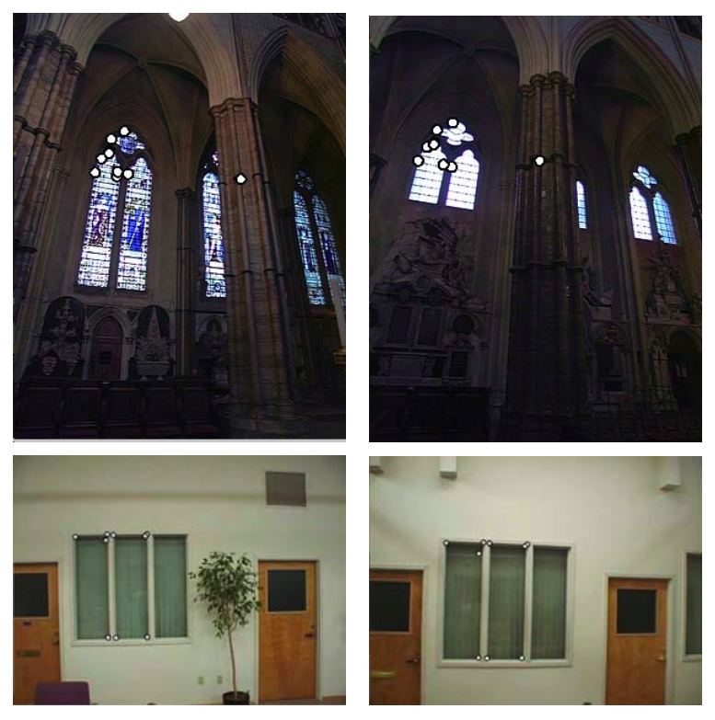
Recognizing panoramas

Slide 17
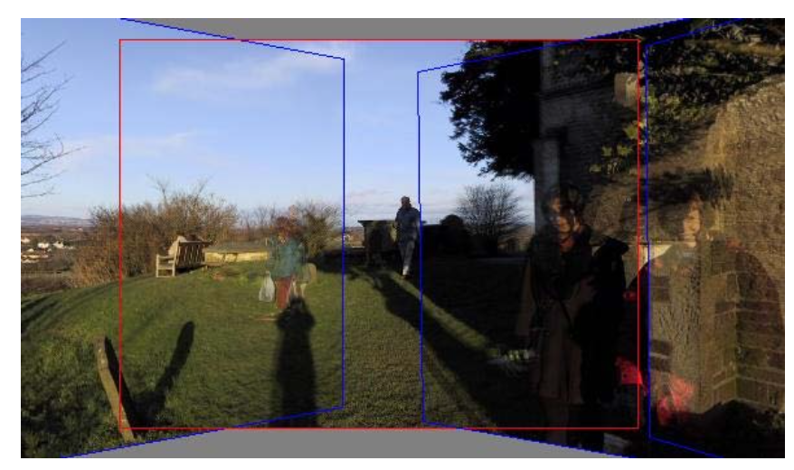
Recognizing panoramas
Validation of image matches by direct pixel error comparison can fail when the scene contains moving objects
→ Solution: machine learning

Slide 18
Summary
What is global alignment in image processing?
Understand about Bundle adjustment.
Study some local adjustments, such as parallax removal
Study panorama recognition

